Slide 1


CS 513
KNOWLEDGE DISCOVERY & DATA MINING
Heart Disease Prediction

Slide 2






OUR TEAM
Shloka Singh
Moksha Dave
Jeet Mehta
Mani Sai Prasad Masupalli

Slide 3













APPROACH
1 - Data Collection
2 - Data Preprocessing
3 - Exploratory Data Analysis
4 - Feature Extraction
5 - Model Selection, Training & Testing
6 - Conclusion

Slide 4
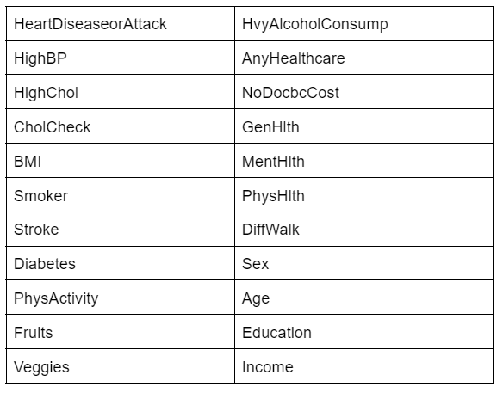
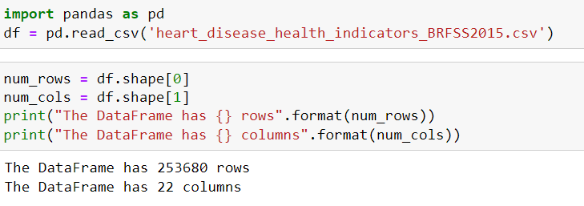
DATA COLLECTION
https://www.kaggle.com/datasets/alexteboul/heart-disease-health-indicators-dataset?select=heart_disease_health_indicators_BRFSS2015.csv
Columns of Dataframe
Link to Dataset
Load Dataframe

Slide 5
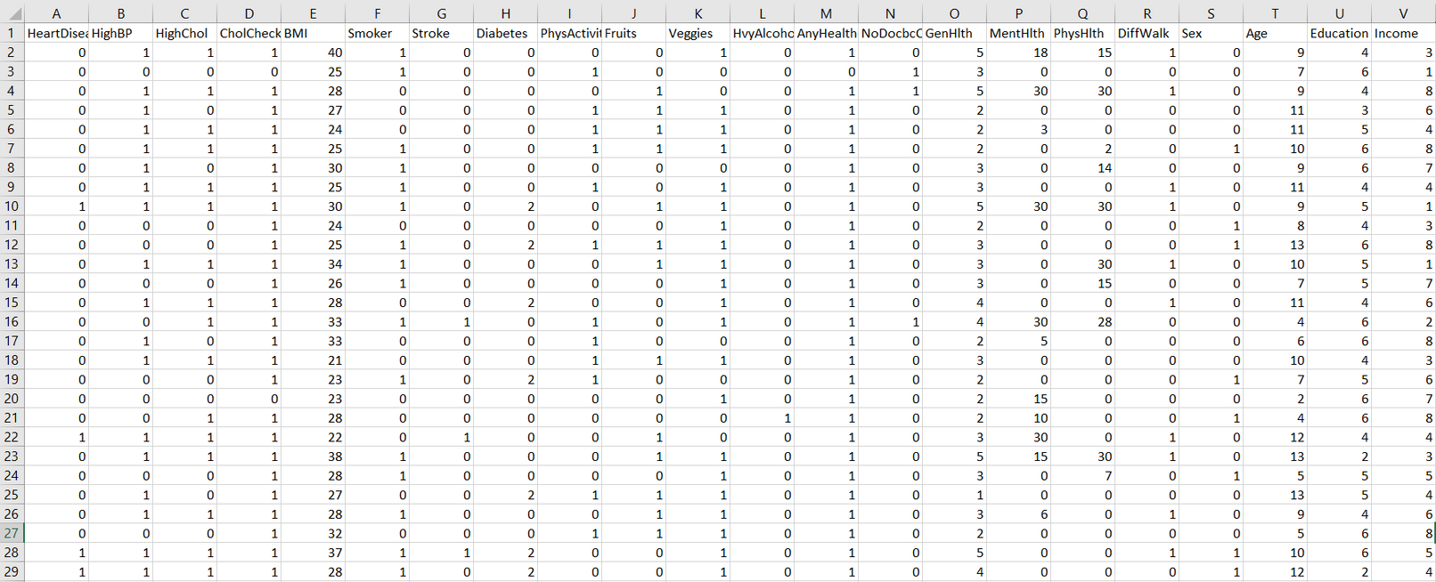
DATA COLLECTION
Dataset Overview

Slide 6
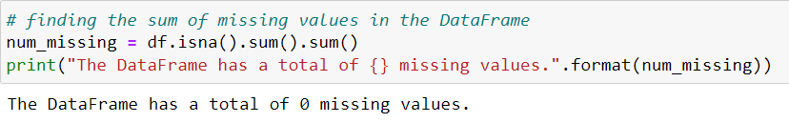
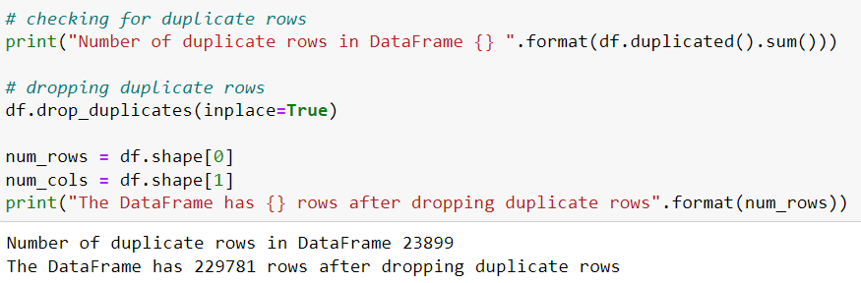
DATA PREPROCESSING
Missing Values
Duplicate Values

Slide 7
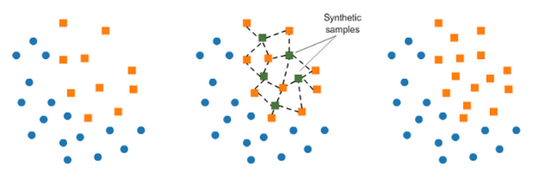
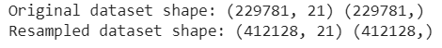
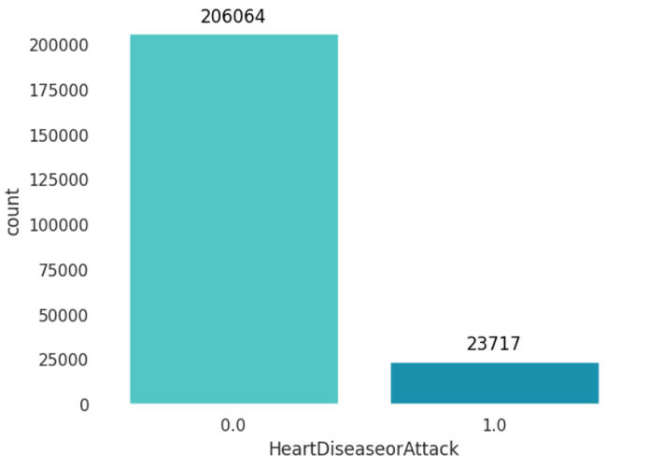
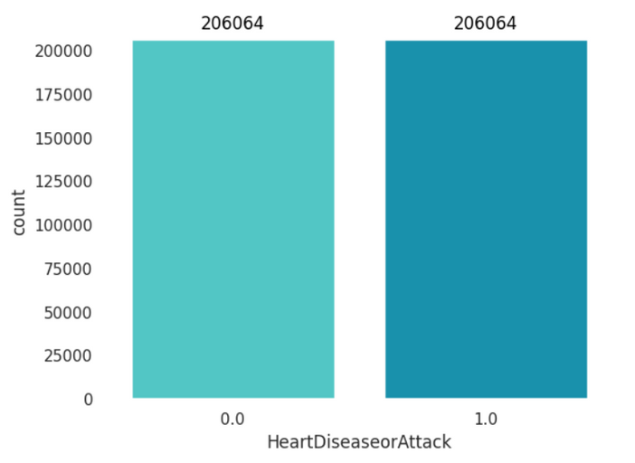
DATA PREPROCESSING
Data Balancing
Synthetic Minority Oversampling Technique
Before Balancing
After Balancing

Slide 8
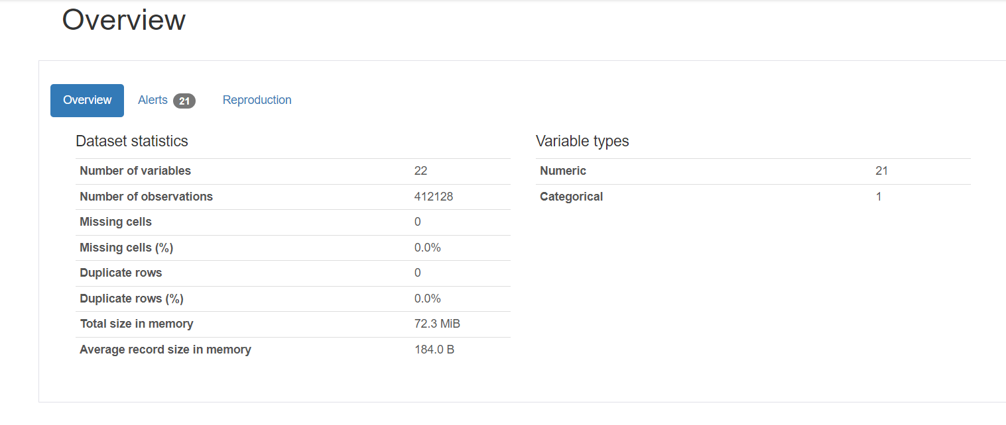
EXPLORATORY DATA ANALYSIS
Balanced Dataset Overview

Slide 9
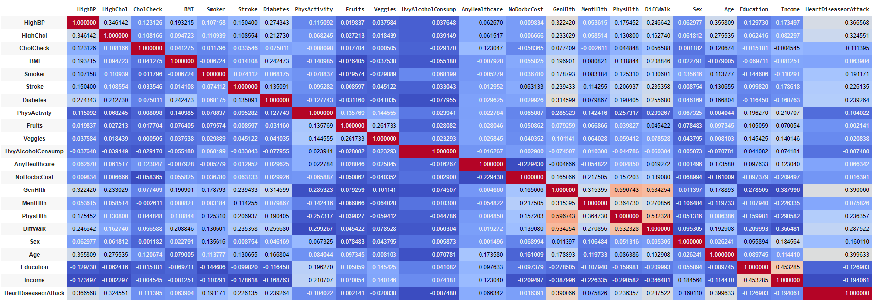
FEATURE EXTRACTION
Correlation Matrix

Slide 10
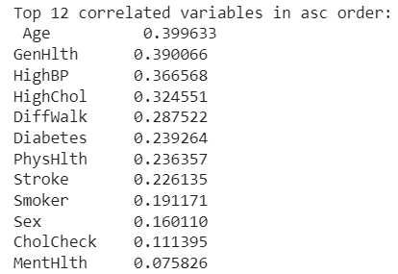
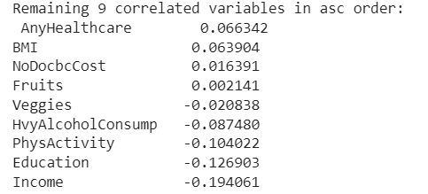
FEATURE EXTRACTION
Top 12 correlated features
Rest 9 features

Slide 11
MODEL SELECTION
Logistic Regression
Decision Trees
Random Forrest
ADABoost
K Nearest Neighbor
SVM
Naive Bayes
ANN

Slide 12
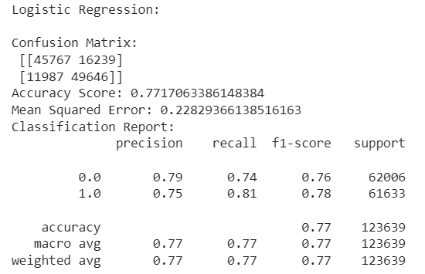
LOGISTIC REGRESSION
Evaluation Metrics

Slide 13
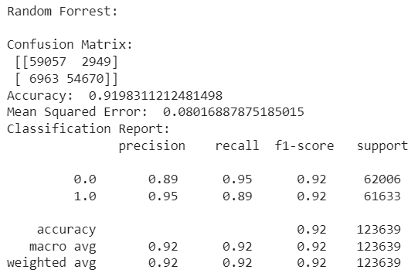
RANDOM FORREST
Evaluation Metrics

Slide 14
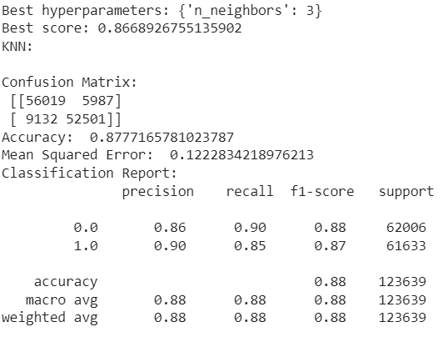
K NEAREST NEIGHBOR
Evaluation Metrics

Slide 15
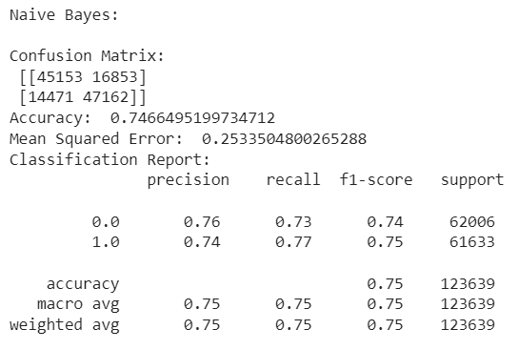
NAIVE BAYES
Evaluation Metrics

Slide 16
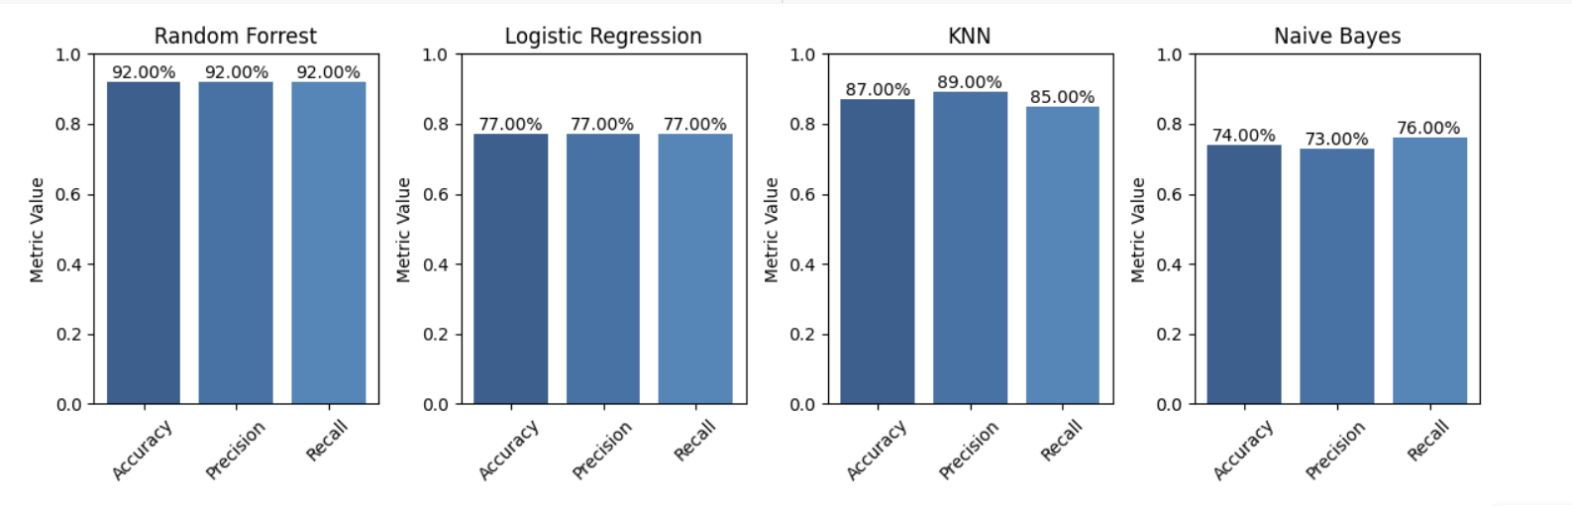
EVALUATION METRICS COMPARISION
Accuracy, Precision & Recall Comparison

Slide 17
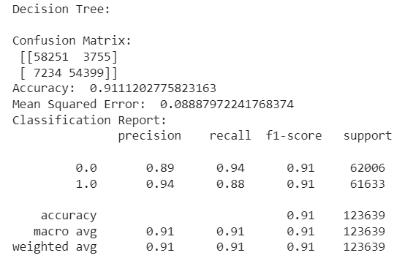
DECISION TREES
Evaluation Metrics

Slide 18
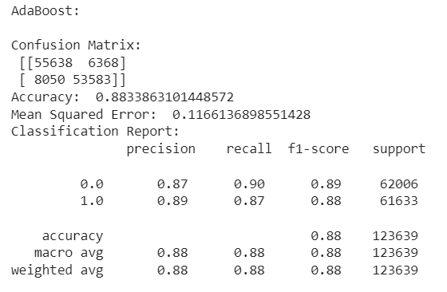
ADAPTIVE BOOSTING(ADABoost)
Evaluation Metrics

Slide 19
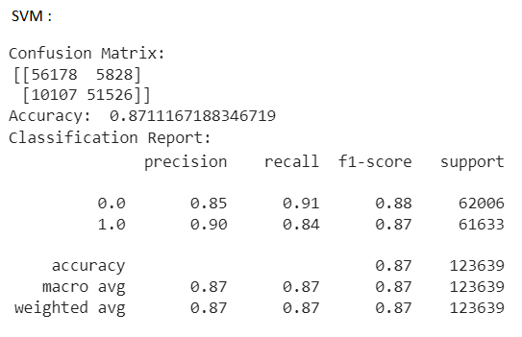
SUPPORT VECTOR MACHINE
Evaluation Metrics

Slide 20
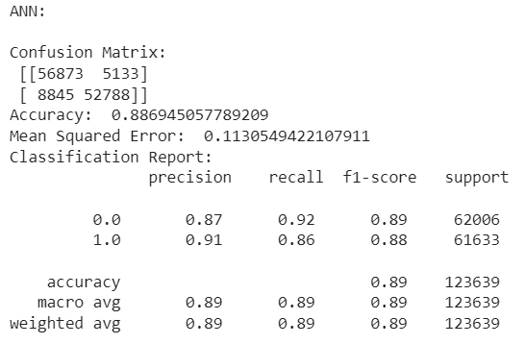
ARTIFICIAL NEURAL NETWORK
Evaluation Metrics

Slide 21
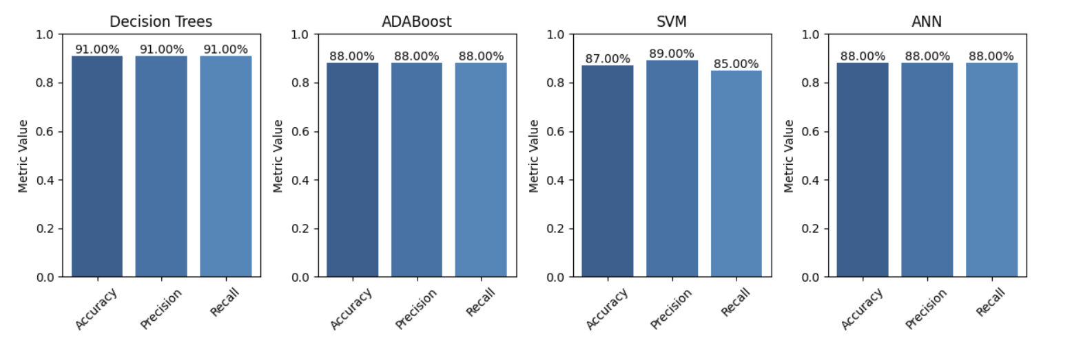
EVALUATION METRICS COMPARISION
Accuracy, Precision & Recall Comparison

Slide 22
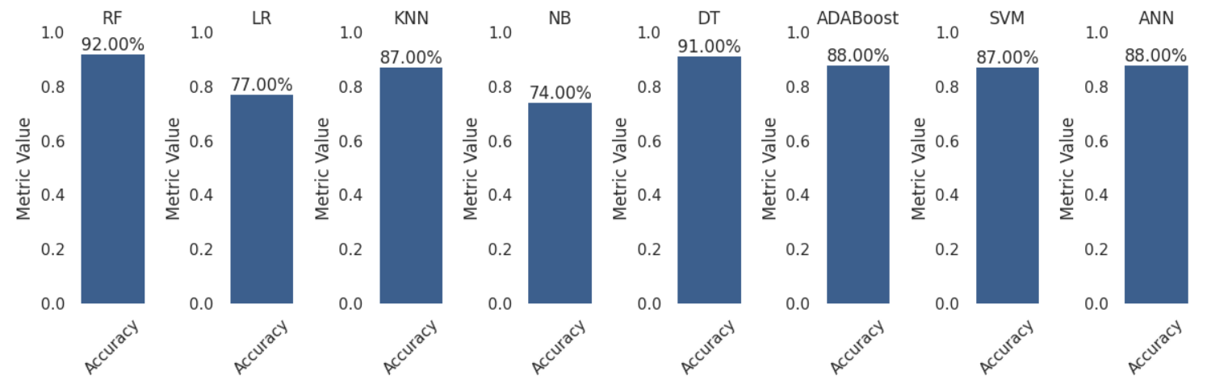
CONCLUSION

Slide 23

Thank
You

